Slide 1



Urban Heat Island (UHI) & Air Pollution Analysis
Internship ID: INTERNSHIP_17513641056863b20937d78

Slide 2

Learning Objectives
Understand the impact of urbanization on air quality
Apply AI/ML techniques for environmental monitoring
Predict AQI values (Regression)
Classify AQI levels (Classification)
Visualize pollution trends and patterns over time
GOAL
Goal: To develop an AI-based system that predicts air quality and monitors urban heat island effects, helping in pollution control and supporting sustainability efforts.

Slide 3
Tools and Technology used
Programming language: Python
Libraries: NumPy, matplotlib , pandas ,scikit-learn, seaborn
Application: Jupyter notebook ,GitHub
Dataset: Air Quality Dataset (CSV format)

Slide 4
Methodology
1. Data Preprocessing (cleaning, missing value handling, feature engineering)
2. Feature Engineering (extracting Year, Month, Day; creating AQI levels)
3. Training and Testing regression and classification models
4. Model Evaluation (MSE, R², Accuracy, Precision, Recall, F1)
5. Visualization (Confusion Matrix, AQI trends, Actual vs Predicted plots)

Slide 5
Problem Statement:
Urban areas face rising air pollution due to rapid urbanization, industrial activities, and vehicular emissions. Poor air quality leads to severe health risks and environmental degradation. Traditional monitoring systems often provide delayed or limited insights. There is a need for an AI-based system that can analyze environmental data, predict Air Quality Index (AQI), and classify pollution levels to support better monitoring, control measures, and sustainable urban planning.

Slide 6
Solution:
To address the issue of rising pollution and limited monitoring systems, this project develops an AI-based framework for environmental monitoring and pollution control. The solution involves:
-Preprocessing air quality data by handling missing values, extracting useful features (Year, Month, Day), and categorizing AQI into levels.
-Regression models (RandomForest, GradientBoosting) to predict AQI values and track pollution trends.
-Classification models (RandomForest with SMOTE, Stacking Classifier) to categorize air quality into Healthy vs Unhealthy.
-Visualizations (confusion matrix, AQI trends, feature importance) to make results interpretable and actionable.
This approach provides a scalable way to monitor air quality, predict future pollution levels, and support policymakers in taking preventive measures for sustainable urban environments.

Slide 7
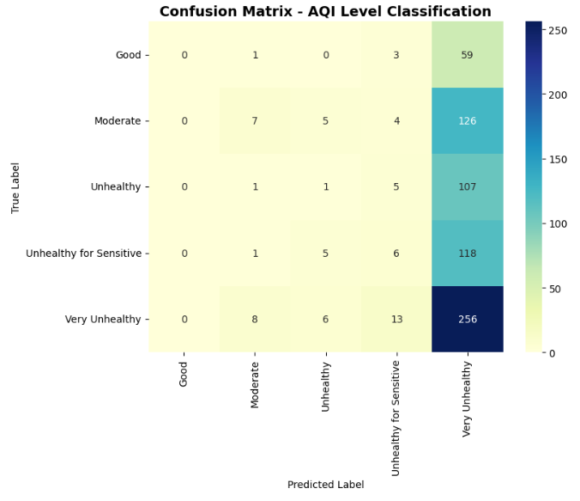
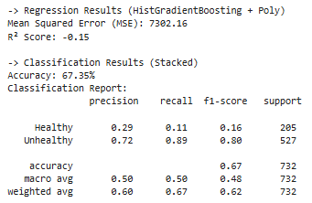
Screenshot of Output:

Slide 8
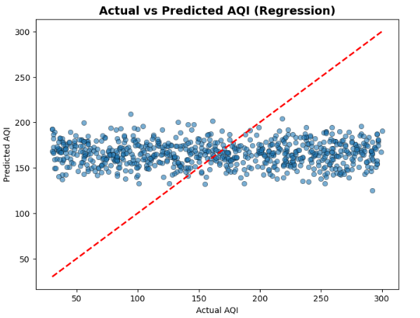
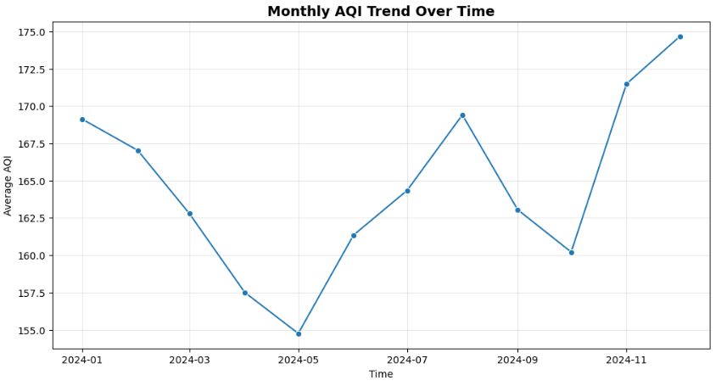

Slide 9
Conclusion:
This project demonstrated how AI and machine learning can be applied to environmental monitoring and pollution control. The system was able to preprocess air quality data, extract useful features, predict AQI, and classify air quality levels into categories such as healthy and unhealthy. The work highlights the potential of data-driven approaches for supporting sustainable urban development, while also showing the challenges posed by noisy and limited datasets. Visualizations help to clearly understand pollution patterns, making it a valuable tool for sustainable urban planning.

